Slide 1
ADVANCED COMPUTER NETWORKS
Aziz Abushark 20332134

Slide 2
Web Proxy Server
Hi

Slide 3
01
Requirements
Assignment 1

Slide 4
Respond to HTTP & HTTPS requests and should display each request on a management console. It should forward the request to the Web server and relay the response to the browser.You can organize your ideas clearly
Handle Websocket connections.
Dynamically block selected URLs via the management console.
Efficiently cache HTTP requests locally and thus save bandwidth. You must gather timing and bandwidth data to prove the efficiency of your proxy.
Handle multiple requests simultaneously by implementing a threaded server

Slide 5
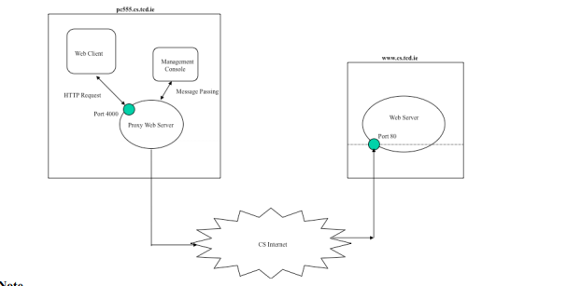
Protocol Design The goal of this project was to create a web proxy that can handle both http/https and websocket queries and support dynamic URL blocking. To handle several connections at once, the needed to implement both a cache and multiple threads.

Slide 6
Implementation
A new thread is started, and the connection is then handled on that thread if the proxy receives a request from the client on a specific port. This permits numerous connections at once. The method and URL are first gathered by parsing the request line. If the URL is not prohibited, once we know these, we can determine whether the request is HTTP or HTTPS and handle it accordingly. HTTP is implemented with a cache.

Slide 7
HTTP vs HTTPS
The request line is processed once a request is received to determine the method and URL. Whereas HTTPS utilizes CONNECT, HTTP employs the GET technique. Once the method has been identified, we may process the request appropriately. We establish a connection for HTTP and, if the server's data is not empty, deliver it to the browser. When a chunk of 0 length is received, the connection is terminated. To make subsequent queries more efficient, HTTP responses are cached. As HTTPS is a secure protocol, we must first establish a connection (3-way handshake), and then we forward data from the server to the client just like we do with HTTP (browser). For HTTPS, we don't cache anything.

Slide 8
Thank you for watching

